Slide 1
Writing Papers in the Biological Sciences
An introduction to Biological research and paper writing

Slide 2
Chapter One: Locating and Using Biological Research
Primary Sources:
  primary sources are reports of original ideas and research in the laboratory or the field. These generally take the form of peer-reviewed research papers in scholarly journals and are directed toward a scientific audience
  Examples: Nature, Science, J plant Physiology…etc
  Clue to recognize a Primary Resource: Your clue to recognizing primary literature is usually the presence of a Materials and Methods section, or at least some mention of methodology, as well as a Results section, typically with accompanying tables or figures. These components indicate that the author is presenting new data and ideas.

Slide 3
Secondary Sources:
Secondary sources are more general works that are based on primary sources. Many are written for readers with little knowledge of the sciences.
Examples: These include books on natural history, the environment, and other scientific subjects, as well as articles in magazines, review papers that summarize and interpret the primary literature in a particular subject area.

Slide 4
Steps for litreature research:
  Textbook
  General texts on the subject
  Encyclopedias
  Science Magazines
  Review Papers
    Literature cited section will help

Slide 5
Scientific Abstracts
  Contain sources you can use for research
  Summary of paper
  Examples are given

Slide 6
Vocabulary:
  Watch what you are searching for (key words)
  Truncating while searching databases
    Cut off part of the word (use the root) to increase search results
    Example: estuar* (instead of estuary) will look up all words starting with estuar
    (estuary meaning: is the tidal mouth of a large river, where the tide meets the stream)

Slide 7
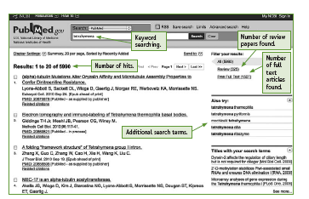
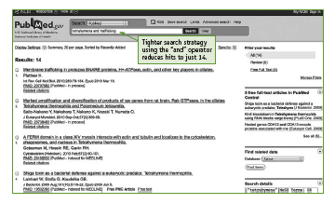

Slide 8
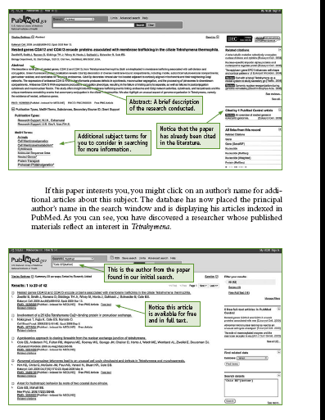

Slide 9
Literature Cited:
  Use your primary resources!!!!!
Use the Literature Cited or References section of relevant papers to find additional primary sources.

Slide 10
Using the Internet
  Know your background so you don’t get lost
  Search Engines
    PubMed
    Gene Bank
    Protein data bank
  Evaluate the website
    Questions to ask
    Websites for evaluating are in your reading
  Records
    KEEP YOUR BIBLIOGRAPHY AS YOU GO!!!

Slide 11
Your best strategy is to consider the following criteria:
• Authority. Who is the author? Does that person do research at an educational institution or a sponsored government agency? What is the
author’s purpose? Can you find his or her name in any of the biology
databases? Have other biologists cited this author’s work?
• Sponsorship. Who is the sponsor of the Web site? Is it a commercial or
not-for-profit enterprise? Does that matter for your search? Is the argument or message of the Web site balanced in tone, or does it appear
biased? Are the sources reputable? Are there advertisements?
• Content. Did you find reliable scientific information? How do you know?
Are the author’s conclusions supported by references or backed by an
organization? Is there a print equivalent of this work?
• Currency. When was the Web site established? How recently was the Web site updated? How new is the information? Is the coverage complete?
• Accuracy. Are there typos or misspellings? Jargon?

Slide 12
How to read a scientific paper
  Background knowledge: language and key terms
  Abstract: READ FIRST! It saves time
  Understand the basics: hypothesis and predictions
  Materials and Methods: don’t freak out!
  Results: Again, don’t freak out, look for MAJOR findings, pay attention to tables and graphs - they do a good job of summarizing
  Discussion: What is the authors argument?
  Re-read if you need to.

Slide 13
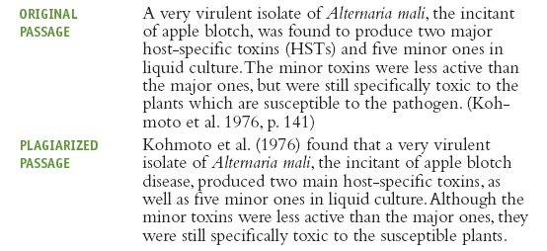
Taking notes:
  AVOID Plagiarism
    Definition
    Reflects note taking skills
    Work on paraphrasing and summarizing

Slide 14
  Orderly system of notetaking
    Notecard system - best for simple research
    Computer
    Hand written in notebook
    DO NOT FORGET TO WRITE DOWN SOURCES AS YOU GO!
    Distinguish between your ideas and the authors ideas

Slide 15
Be selective with your notes
  Don’t go overboard. If you are unsure of the importance of a source, keep the abstract or a very short summary of the article.
Sources
  Keep a master list of all your sources
  If you use any idea from a source in your paper, you must cite it!
*****Chapter six will show you how to cite.

